Slide 1
Multiple Linear Regression
Osama Bin Ajaz
Lecturer at FAST – NUCES

Slide 2

Multiple Regression Model
In multiple regression, there are several independent variables and one dependent variable, and the equation is:

Slide 3
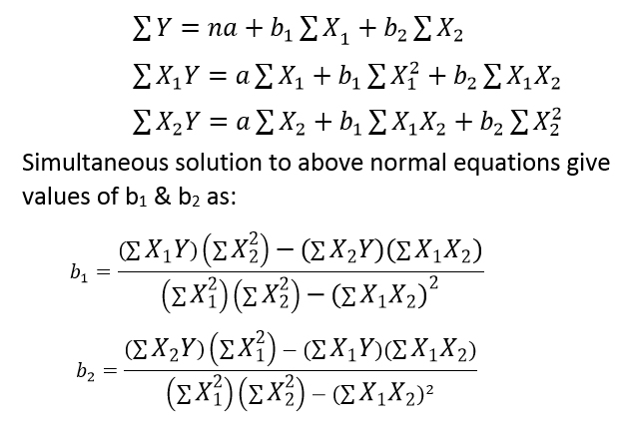
Normal equations for Regression Coefficient for two independent variables

Slide 4
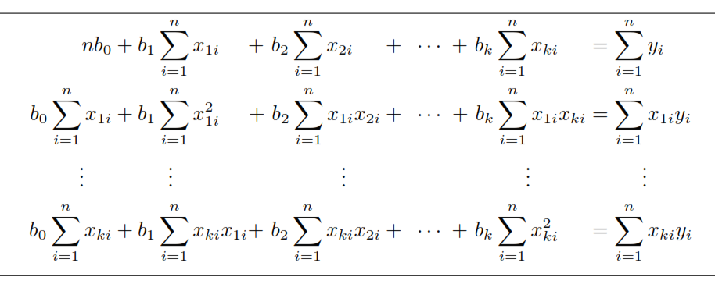
Normal equations for K independent variables
Here a = bo

Slide 5
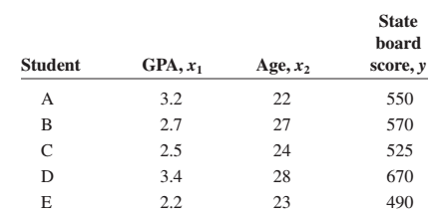
Example # 01
For example, suppose a teacher wishes to see whether there is a relationship between a student’s grade point average, age, and score on the state board examination. The two independent variables are GPA (denoted by x1) and age (denoted by x2).

Slide 6


Example # 01
The multiple regression obtained from the data is:
if a student has a GPA of 3.0 and is 25 years old, the student’s predicted state board score is:

Slide 7
Assumptions for Multiple linear Regression
E (ϵ) = 0
The regression equation is linear in the parameters.
V(ϵ) = σ².
The population distribution of ϵ is normal.
The values for the y variables are independent.
The independent variables are not correlated.

Slide 8
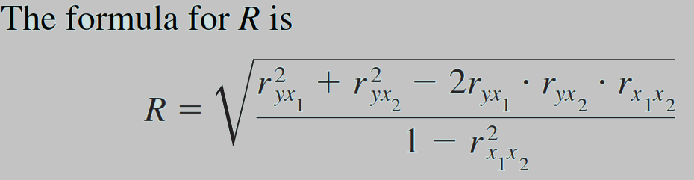
Multiple Correlation (R)
The value of R takes into account all the independent variables.
The value of R can range from 0 to 1; R can never be negative.
The closer to 1, the stronger the relationship; the closer to 0, the weaker the relationship.

Slide 9
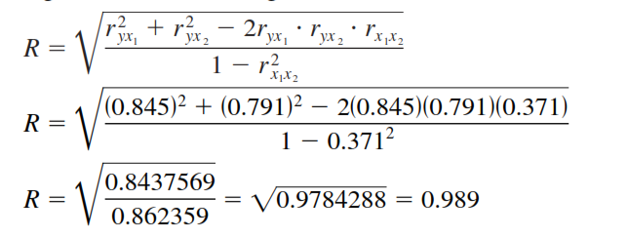
Example # 02
For the data regarding state board scores, find the value of R.

Slide 10
Coefficient of Multiple Determination (R²)
R² is the coefficient of multiple determination, and it is the amount of variation explained by the regression model.

Slide 11

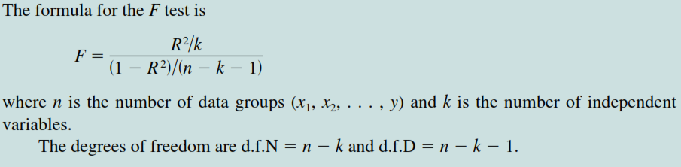
Significance of R
An F test is used to test the significance of R. The hypotheses are

Slide 12
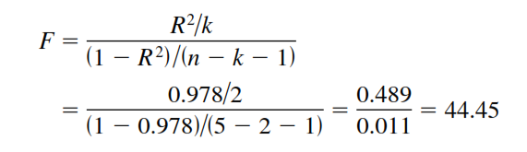
Example # 03
Test the significance of the R obtained in Example 02 at α = 0.05.
The critical value obtained, d.f.N (υ1)= 3, and d.f.D (υ2)=5 - 2 -1 = 2 is 19.16. Hence, the decision is to reject the null hypothesis.

Slide 13
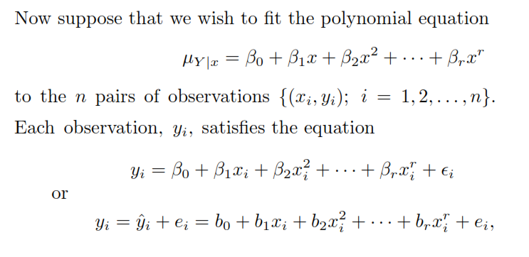
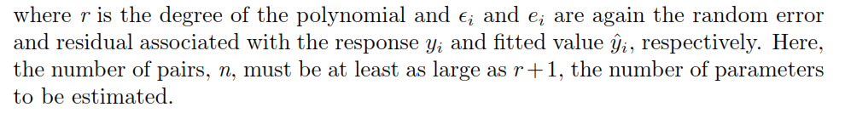
Polynomial Regression

Slide 14

Polynomial Regression (Contd.)
Notice that the polynomial model can be considered a special case of the more general multiple linear regression model, where we
The normal equations assume the same form as those given in previous slides (slides 3 & 4).

Slide 15
Example # 04
Given the data
ﬁt a regression curve of the form and then estimate

Slide 16
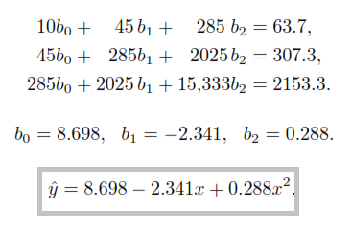

Example # 04 (Contd.)

Slide 17

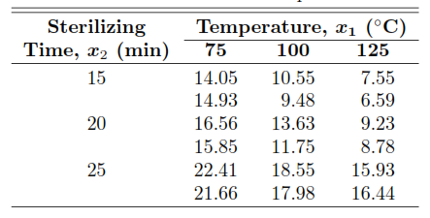
Example # 05
The data given below represent the percent of impurities that resulted for various temperatures and sterilizing times during a reaction associated with the manufacturing of a certain beverage. Estimate the regression coeﬃcients in the polynomial model

Slide 18
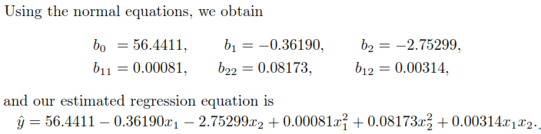
Example # 05 (Contd.)

Slide 19
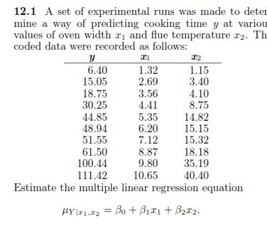
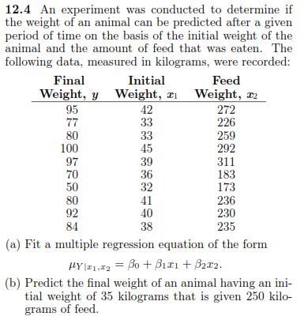
Practice Questions

Slide 20
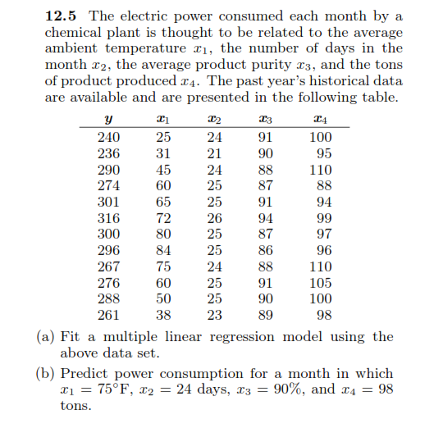
Practice Questions (Contd.)

Slide 21
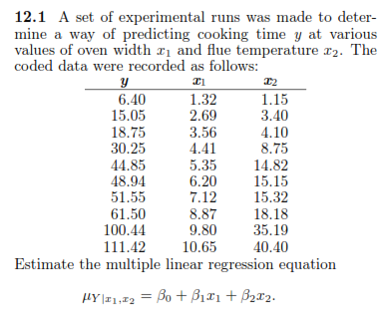
Practice Questions (Contd.)

Slide 22
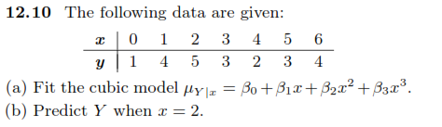
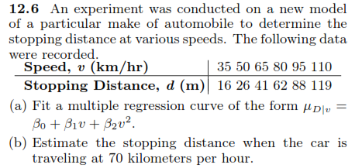
Practice Questions (Contd.)

Slide 23
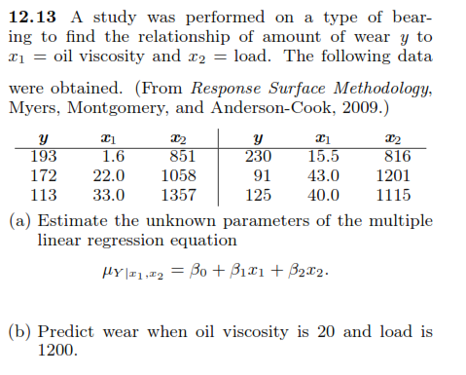
Practice Questions

